Slide 1
INDUSTRIAL HUMAN RESOURCE – VISUALIZATION

Slide 2
INTRO
Problem Statement :
"In India, the industrial classification of the workforce is crucial to understand labor distribution across sectors“.
"Current data on main and marginal workers is outdated and may not reflect the current state of the workforce“.
"The aim of this study is to provide accurate data for policy making and employment in less employed states and districts“.

Slide 3
TOOLS
Technologies and Tools:
Python as the programming language.
Streamlit for web application.
Pandas for data manipulation.
Matplotlib and Plotly for data visualization

Slide 4
APPROCH
Project Workflow :
Data Loading: Use of Pandas to load human resource data from CSV.
Preprocessing: Clean and preprocess data, including splitting column.
Feature Eng : Added additional columns for exploration
Data Exploration: Explore data using St for user-friendly interaction.

Slide 5
EDA & NLP
Key Findings:
Total Workers in each state & district(Main & Marginal).
Distribution of workers in rural, main and urban areas.
Male female ratios among workers.
Visualization of marginal workers in rural and urban areas
Visualization of workers based on category with was done using NLP

Slide 6
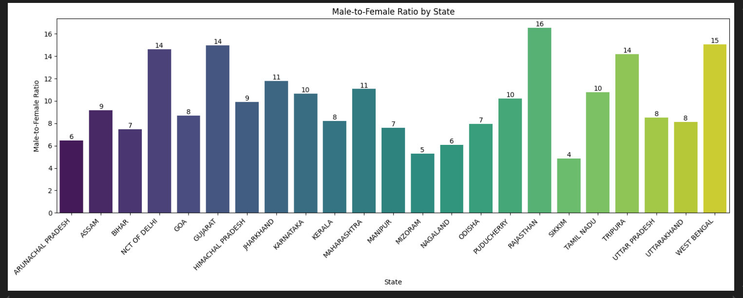

Slide 7
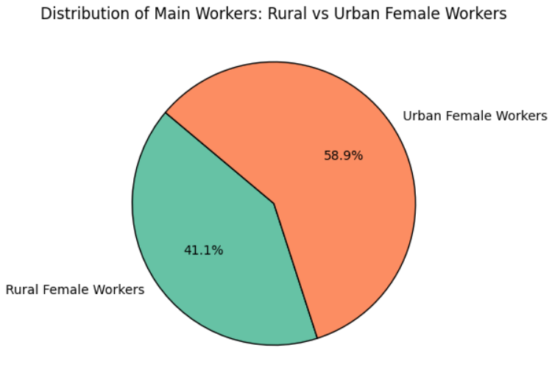

Slide 8
THANK YOU!

